Slide 1
FHIR IG Training
Melva Peters
September 11-12, 2019

Slide 2
Topics
Project Scope Statement (PSS)
Implementation Guide proposals
Publication checklist
Using Zulip and WG Calls

Slide 3
HL7 Processes
Some of the process steps may be managed by WG Co-Chairs or by a Project Manager
But you should be aware of the processes at least at a high level

Slide 4
Confluence Pages and Checklist
A set of Confluence pages have been set up to provide guidance on FHIR IG processes
https://confluence.hl7.org/display/HL7/FHIR+Implementation+Guide+Process+Flow
Walk through each process, relevant steps and dependencies
Include links to relevant documents and forms

Slide 5
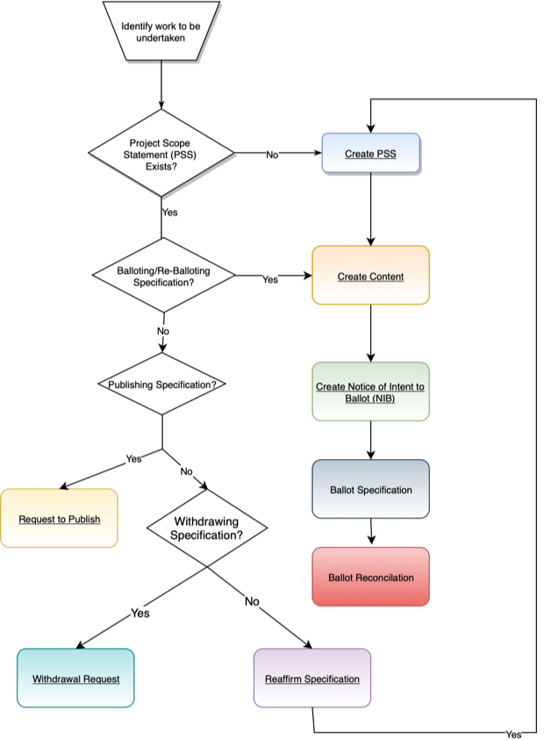
FHIR IG Process Flow
https://confluence.hl7.org/display/HL7/FHIR+Implementation+Guide+Process+Flow
There are some FHIR specific requirements to be aware of

Slide 6
Calendars
HL7 Calendars
https://confluence.hl7.org/display/HL7/HL7+Calendars
FHIR specific dates
https://confluence.hl7.org/display/HL7/HL7+FHIR-specific+dates

Slide 7
Upcoming Dates
WG Approvals of PSS – 2019-10-04 (May 2020 Ballot Cycle
Notice of Intent to Ballot (NIB) – 2019-11-17 for January 2020 Ballot Cycle
Harmonization – 2019-11-21 – Final Proposal Deadline
Initial content – 2019-12-01
Ballot reconciliation deadline – 2019-12-08
Final content deadline – 2019-12-22
Ballot Readiness Sign-off – 2019-12-24

Slide 8
FHIR Specific Dates
FHIR IG Proposals Due – 2019-11-03
FHIR IG substantially complete – 2019-11-17
FHIR ballot core substantive freeze – 2019-11-29
FHIR QA Deadline
FHIR Final QA Deadline
FHIR Connectathon Proposals Due – 2019-12-03

Slide 9
Appeal Deadlines
Appeal process through Technical Steering Committee (TSC) if dates are missed
Missed NIB deadline – 2019-11-19
Missed initial content deadline – 2019-12-03
Missed final content deadline – 2019-12-24

Slide 10
Project Scope Statements (PSS)
Project Scope Statements
Mechanism to communicate the activity being undertaken
Must provide sufficient information to allow inexperienced individuals to anticipate what a WG is working on and decide if they wish to become involved
Also the mechanisms for WGs to manage the work
https://confluence.hl7.org/display/HL7/A+-+Project+Scope+Statement

Slide 11

PSS
Previously submitted via a Word Document, now using Confluence
PSS Help and FAQs: https://confluence.hl7.org/display/PSS/PSS+Help+and+FAQs
Confluence
Click “Create …”
Search for “Project” and select “HL7 Project Scope Statement Form”

Slide 12
PSS – Key Requirements and Approvals
Used for work underway in HL7 - to be balloted/published by HL7
Must be approved by a sponsoring Work Group
May have co-sponsoring Work Group(s) – must be approved by all
If US Realm, must be approved by the US Realm Steering Committee
Forward to tscpm@HL7.org
FHIR IG – must be approved by FHIR Management Group (FMG)
Forward to fmgcontact@hl7.org
Must be submitted to Project Management Office (PMO)
Forward to pmo@hl7.org
Must be approved by Steering Division (SD) of sponsoring Work Group
Must be approved by Technical Steering Committee (TSC)
This is handled by SD Co-Chairs once approved in the SD
Deadline for approval for PSS for the next cycle
4 weeks before the WGM (e.g. deadline for PSS for Feb 2020 Ballot cycle was 2019-08-16)
May 2020 Ballot Cycle - 2019-11-17

Slide 13
Implementation Guide (IG) Proposal
FMG requires the submission of an IG Proposal
Template: https://wiki.hl7.org/Template:FHIR_IG_Proposal
Must be submitted to FMG at least 3 weeks prior to the NIB (Notice of Intent to Ballot) deadline
Must be approved by FMG by the NIB deadline

Slide 14
Notice of Intent to Ballot (NIB)
NIBS – submitted by WG Co-Chair
Links:
http://www.hl7.org/special/committees/tsc/specialuploads/NIB_Instructions.pdf
Current Cycle NIBs

Slide 15
NIB – Key Requirements and Approvals
Content of IG must be at FMM level 2 (if balloting as STU) or FMM level 5 (Normative) prior to submission of NIB
IG Proposal must be approved by FMG before NIB submitted
PSS must be submitted to PMO
Content must be substantively complete
Not focused on actual content, but rather:
All artifact types must be defined and working
Any complexity must be identified
Structures and inheritance must be defined
Tooling issues identified
If anything introduced after this that breaks IG build, will not be fixed

Slide 16
Ballot/Publication Readiness Checklist
Content of IG must be at FMM level 2 (if publishing as STU) or FMM level 5 (Normative) prior to submission of publication request (or exception has been received from FMG
Ballot reconciliation for previous ballot
Must be complete before going to ballot again or publication
For January 2020 Ballot cycle: Deadline is 2019-12-08

Slide 17
Ballot/Publication Readiness Checklist
FHIR QA deadline – 2 weeks before final content deadline
The IG must be totally complete
Sponsoring WG must approve content
may identify quality issues with it that can then be fixed
FMG approval
May be reviewed by the FMG who will check that it is "sufficiently complete to be ready for ballot" - which for STU means that it looks fully implementable and that there aren't missing pieces.
It's not kosher to have the IG 'mostly' complete and expect to fix outstanding issues during the QA period.
If the IG author wishes, they can approach the relevant work group(s) and see if they're willing to accept a shorter review period. The shortest possible review period permitted would be start in one week. If all relevant work groups accept a later date, the QA deadline becomes the earliest of the deadlines the work group(s) accept or one week from this deadline.

Slide 18
Ballot/Publication Readiness Checklist
Co-sponsoring WGs must approve content
FHIR IG’s must meet IG quality criteria
https://confluence.hl7.org/display/HL7/3.+FHIR+IG+Quality+Criteria
Prior to ballot or publication, readiness checklist must be completed and submitted
Checklist confirms that each of the requirements has been met

Slide 19
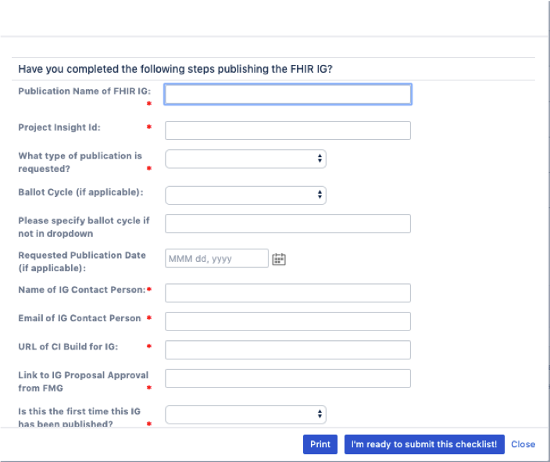
Checklist
Some of the content for the checklist were specified in the IG proposal

Slide 20
Common Issues with FHIR IGs
Correct (new) HL7 logo
Publisher ("HL7 International - <workgroup full name>" and contact)
History page listing all other releases
Realm issues
Version issues – All the versions matching across artifacts

Slide 21
Common Issues with FHIR IGs
Header and Footer information
Everything is included
Publish box
Missing downloadable zip file containing the full content of the IG

Slide 22
Monitoring during Ballot Cycle
Status of IG’s in current ballot cycle is monitored by FHIR Ballot Facilitator
Emails are sent out to developer to obtain information and as reminders through out ballot cycle
Starting after NIB deadline
Purpose is to support
Developers
Meet requirements
Meet deadlines and other criteria
FMG
in monitoring IG development

Slide 23
Using Zulip
http://chat.fhir.org
Relevant streams to subscribe to:
IG Creation
https://chat.fhir.org/#narrow/stream/179252-IG-creation
Implementers
https://chat.fhir.org/#narrow/stream/179166-implementers

Slide 24
Using Calls
Review and approval by Work Groups
Make sure you are aware of the sponsoring and co-sponsoring Work Groups
For review of final content during QA period
Submit material to WG Co-Chair(s)
Schedule time on WG teleconference to review content and seek approval
Approval must be in WG minutes

Slide 25
Questions
For more information about processes:
PMO@hl7.org
melva@jenakerconsulting.com
Questions?

